Slide 1
AI-Powered Chronic Kidney Disease
Risk Prediction and Analysis
Machine Learning Project – Abstract Presentation
Prepared by: J. Sohan (2520080060) | J. Sricharan (2520090137)
Guide: Ms. Chekuri Anitha, Assistant Professor
Department of AI&DS and CSIT • A.Y. 2026–27

Slide 2
Abstract
AI-assisted early risk prediction for Chronic Kidney Disease
Chronic Kidney Disease (CKD) is a serious condition that requires early detection to prevent severe health complications. This project uses machine learning to predict CKD from patient clinical data. The dataset is preprocessed by handling missing values, encoding categorical features, and performing exploratory data analysis. XGBoost and LightGBM are trained and compared using accuracy, precision, recall, and F1-score. The best-performing model is deployed through a Streamlit web application, allowing users to enter patient details and receive an instant prediction. The proposed system aims to provide an accurate, efficient, and user-friendly solution that supports early diagnosis and informed clinical decision-making.
Data Preprocessing
XGBoost
LightGBM
Streamlit

Slide 3
Introduction
Why machine learning can help in CKD risk prediction
• CKD is a long-term condition in which the kidneys gradually lose their ability to filter waste and excess fluids.
• Undetected CKD can lead to serious complications, including kidney failure and cardiovascular diseases.
• Early diagnosis is important for improving treatment outcomes and reducing mortality.
✓ Clinical attributes used include blood pressure, blood glucose, serum creatinine, hemoglobin, and albumin.
✓ The workflow covers preprocessing, feature engineering, model training, and performance evaluation.
✓ XGBoost and LightGBM are compared to identify the most accurate prediction model.
✓ The final model is presented through a user-friendly interface for quick predictions.

Slide 4

Software & Hardware Requirements
Requirements for developing and running the CKD prediction system
Software Requirements
Hardware Requirements
• OS: Windows 10/11, Linux, or macOS
• Python 3.10 or above
• Jupyter Notebook / Google Colab / VS Code
• Pandas, NumPy, Scikit-learn
• XGBoost, LightGBM, Matplotlib, Seaborn
• SHAP and Joblib
• Streamlit web framework
• SQLite / MySQL database
• Git & GitHub; pip package manager
• UCI Chronic Kidney Disease Dataset
• Google Chrome / Microsoft Edge
• Processor: Intel Core i5 / AMD Ryzen 5 or better
• RAM: Minimum 8 GB; 16 GB recommended for smoother model training
• Storage: At least 10 GB free space for Python environment, datasets, and project files
• Display: 1366×768 or higher
• Internet: Required for Google Colab, package installation, GitHub, and deployment
• Optional: Cloud runtime such as Google Colab for larger experiments
Hardware values are practical project recommendations.
Kaggle Dataset – Chronic Kidney Disease
https://www.kaggle.com/datasets/amanik000/kidney-disease-dataset

Slide 5
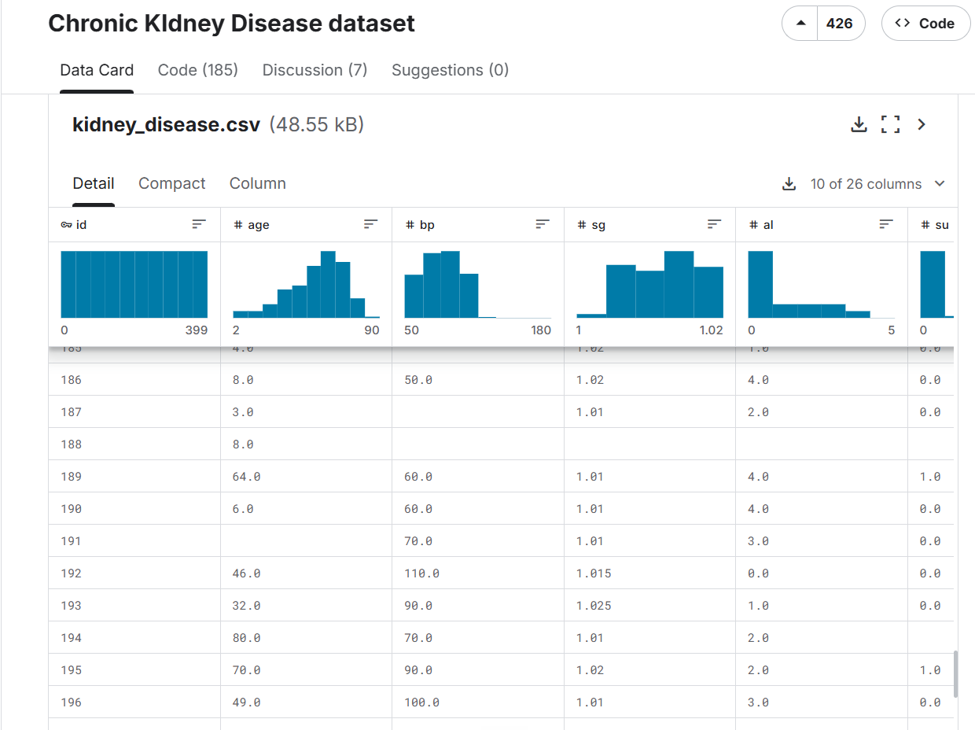
Chronic Kidney Disease Dataset
Kaggle dataset used for model training and analysis
Source: Kaggle — Chronic Kidney Disease dataset

